Slide 1
Addressing modes

Slide 2
Addressing modes
Addressing mode is the manner in which a target address is identified within the instruction.
Examples of addressing modes
Implied addressing
Direct addressing
Indirect addressing
Immediate addressing
Register addressing

Slide 3
Immediate addressing
This is the type of addressing in which the operand is part of the instruction. It is fast.
Direct addressing.
This is the mode of addressing in which the address field contains the address of the operand. It does not require additional calculations to work out effective address.
Indirect addressing.
This is a mode of addressing where the memory cell pointed to by the address field contains the address of the operand. It is slower.
Register addressing.
In this addressing mode, the operand is held in register named in address field. It has very fast execution.
Implied addressing.
This is the mode of addressing in which the operands are specified implicitly in definition of the instruction

Slide 4
Other addressing modes
Register Indirect Addressing.
Base-plus-index addressing
Register relative addressing
Base relative-plus-index addressing:

Slide 5
Direct Memory Access

Slide 6
Direct Memory Access
Direct Memory Access is when an external device accesses the computer memory directly.
Examples of DMA devices include: Network card, sound card, graphic card.
A DMA is required when a multi-byte data set or a burst of data or a block of data is to be transferred between the external device and system or two systems
A device facilitates DMA transfer with a processing element called DMAC (DMA Controller)

Slide 7
Methods of Direct Memory Access (DMA)
Burst Mode:
Here, once the DMA controller gains the charge of the system bus, then it releases the system bus only after completion of data transfer. Till then, the CPU has to wait for the system buses.
Cycle Stealing Mode:
In this mode, the DMA controller forces the CPU to stop its operation and relinquish the control over the bus for a short term to DMA controller.
After the transfer of every byte, the DMA controller releases the bus and then again requests for the system bus. In this way, the DMA controller steals the clock cycle for transferring every byte.
Transparent Mode:
Here, the DMA controller takes the charge of the system bus only if the processor does not require the system bus.

Slide 8
Steps in DMA
Device wishing to perform DMA asserts the processor’s bus request signal.
Processor completes the current bus cycle and then asserts the bus grant signal to the device.
The device then asserts the bus grant ack-signal.
The DMA device performs the transfer from the source to destination address.
Once the DMA operations have been completed, the device releases the bus by asserting the bus release signal.
Processor acknowledges the bus release and resumes its bus cycles from the point it left off.

Slide 9
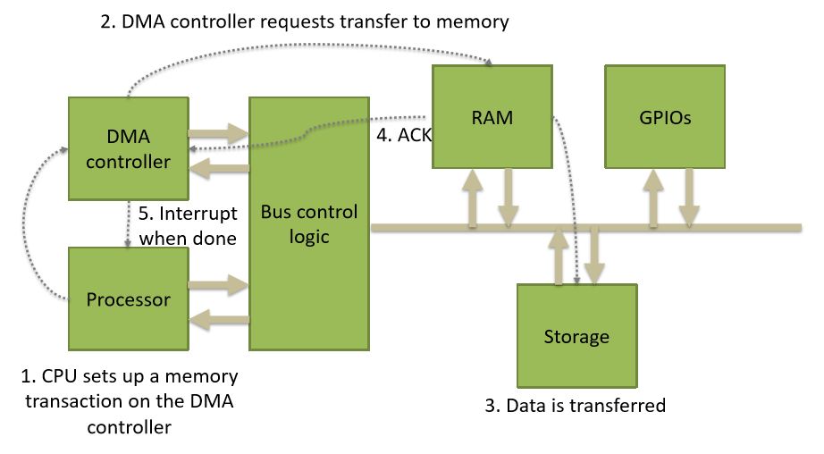
DMA steps cont’d

Slide 10
Dynamic Random Access Memory (DRAM)
DRAM is a type of RAM that stores each bit of data on a separate capacitor. This is an efficient way to store data in memory, because it requires less physical space to store the same amount of data than if it was stored statically.
DRAM is the most common type of memory found in personal computer systems.

Slide 11
ADVANTAGES DRAM
It can be deleted and refreshed while running the program.
It is cheaper compared to Static Random Access Memory (SRAM).
It is smaller in size.
It has higher storage capacity. Hence it is used to create larger RAM space system.
It is simple in structure than SRAM.
DISADVANTAGES
It is volatile. It loses data when power is turned off.
It is slower than Static Random Access Memory (SRAM).
It requires continuous refreshing.
It has low retention of data.
Manufacturing is complex.
It has a high power consumption compared to other options.

Slide 12
STATIC RAM (SRAM)
Static random-access memory is a type of semiconductor random-access memory that uses bi-stable latching circuitry to store each bit.
SRAM stores a bit of data on four transistors using two crosscoupled inverters. The two stable states characterize 0 and 1.

Slide 13
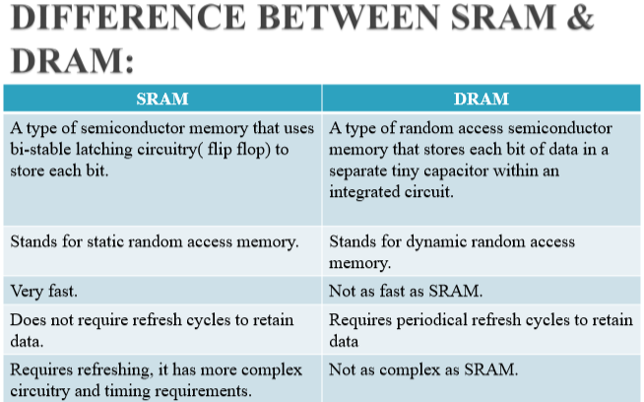
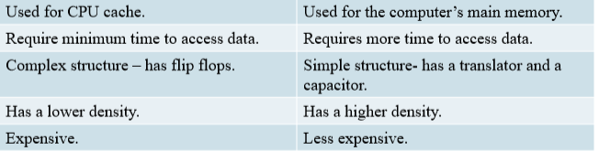

Slide 14
Interrupts
An interrupt is a signal from a device attached to a computer or from a program within a computer that requires the operating system to stop and figure out what to do next.
How processor handles interrupts.
When an interrupt occurs, it causes the CPU to stop executing the current program. Then, comes the control to interrupt handler or interrupt service routine.
Steps
When an interrupt occurs, the program counter points to the next instruction.
The program value is stored on the process stack and the program counter is loaded with the address of the interrupt routine.
Once the interrupt service routine is completed, the address on the process stack is popped and placed back in the program counter.
Now it executes the resume of the previously popped process/instruction.

Slide 15
Types of interrupts
Hardware interrupts – this is an interrupt signal generated from external devices. Hardware interrupts are classified into two types which are as follows.
Maskable interrupt – this is a hardware interrupt that can be delayed when highest priority interrupt has occurred to the processor.
Non Maskable interrupt – this is a hardware interrupt that can not be delayed and immediately serviced by the processor.
Software interrupts - this is an interrupt signal generated from internal devices and software programs which are in need to access any system call. Software interrupts are divided into two types . They are as follows.
Normal interrupts – these are interrupts caused by software instructions.
Exception – these are unplanned interruptions. For example division by zero.

Slide 16
Effects of interrupts
Interrupts decreases waiting time therefore stops wastage of the instruction cycle.
Interrupts enables multi-tasking by allowing the CPU to quickly switch between different processes.
Interrupts simplifies input/output operations by allowing devices to communicate directly with the CPU.
Interrupts provide device independence.
Interrupts provide concurrency and provide a way to respond to external events.
However,
Interrupts consume processor time and cause a context switch.

